Slide 1
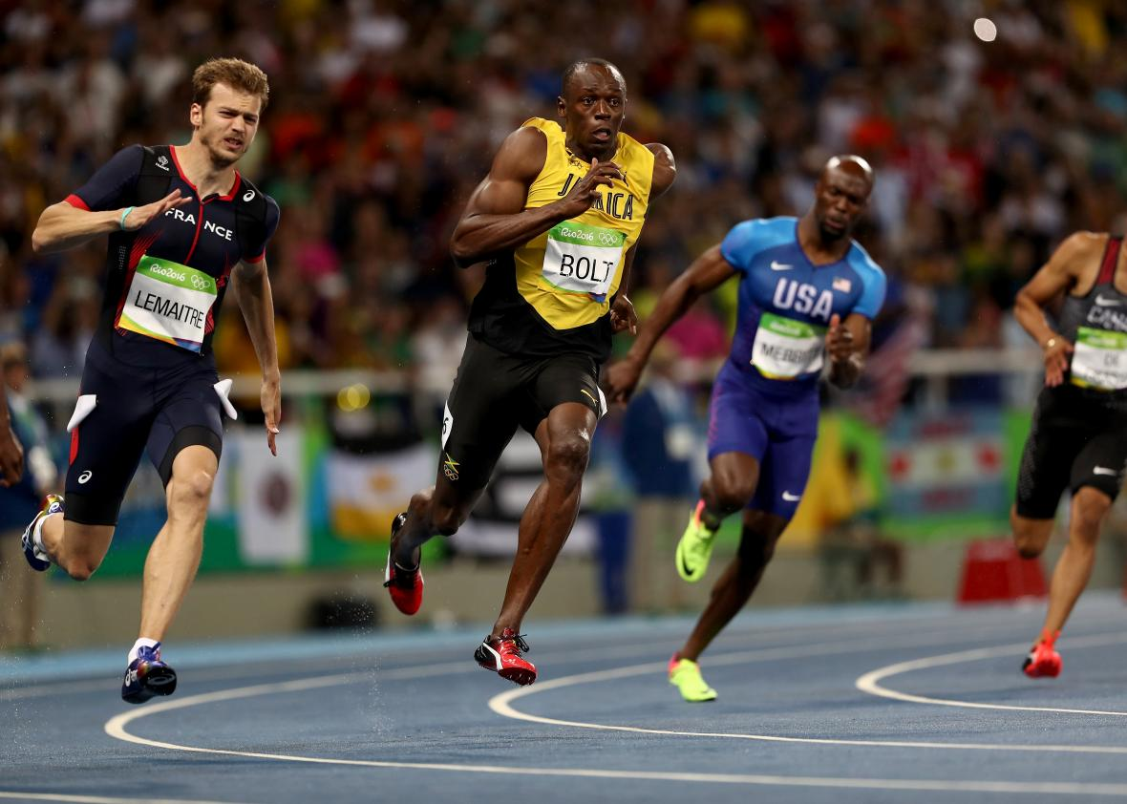
Usain bolt
By Khalil seaman
Year 5

Slide 2
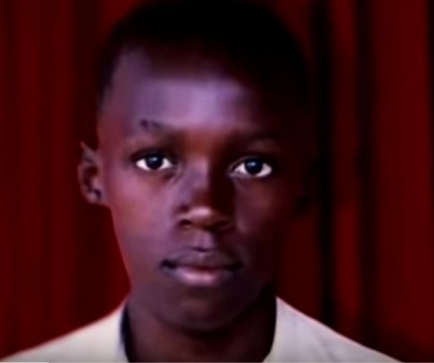
Early life
He was the fastest runner in the world
His full name is Usain St Leo Bolt

Slide 3
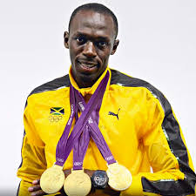
Age
He was born in 1986
He is now 32
He has got 9 gold medals

Slide 4
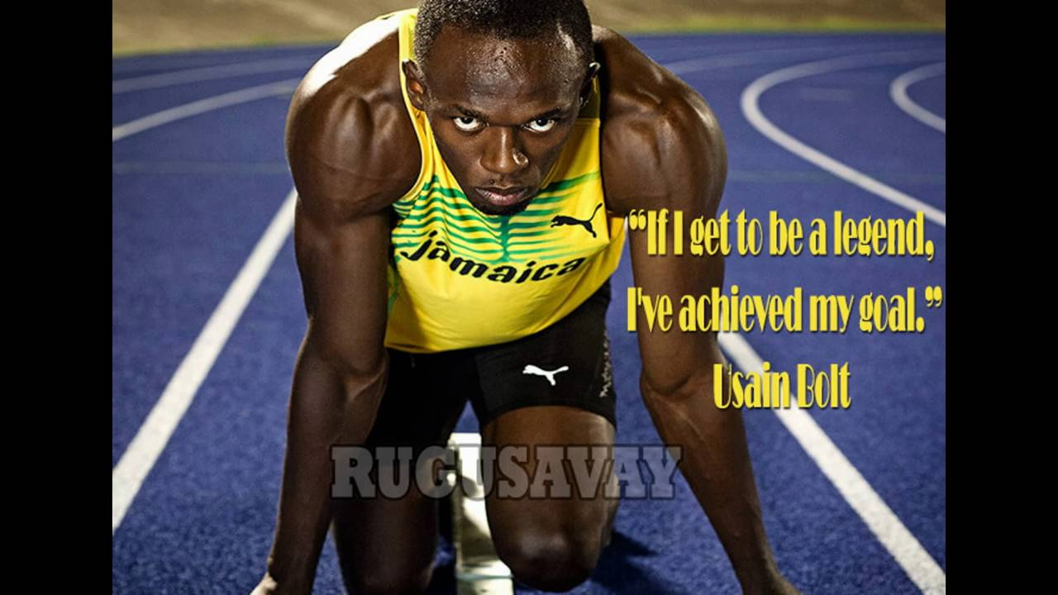
His quotes

Slide 5
Thank you for listening

Slide 6

Any questions ?

